Slide 1
The Seventeenth Century and the Dawn of the Global World
英文一 王信婷
英文一 陳睿平
英文一 賴品妤
英文一 呂季儒
VERMEER’S HAT

Slide 2
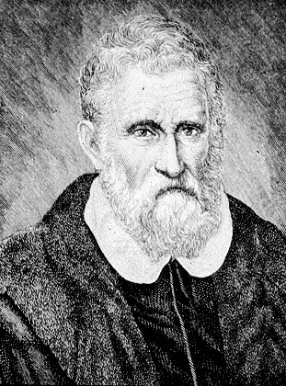
THE DREAM OF GETTING TO CHINA
Marco Polo The role of activator催化劑 (P. 47 L. 1 to L. 10)
Effect Strengthen Europeans' desire to get to China

Slide 3
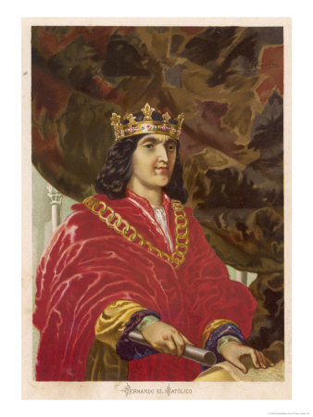
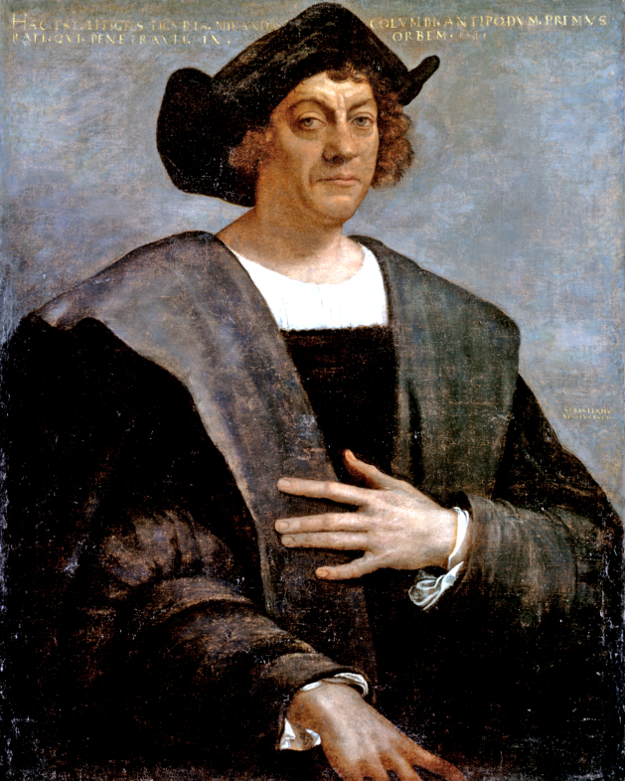
THE DREAM OF GETTING TO CHINA
Examples Christopher Columbus King Ferdinand

Slide 4
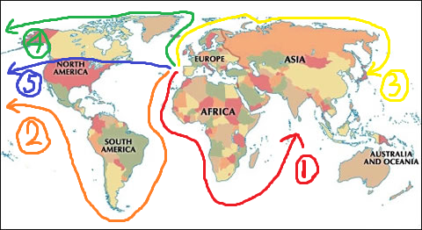
THE ROUTES OF GETTING TO CHINA

Slide 5
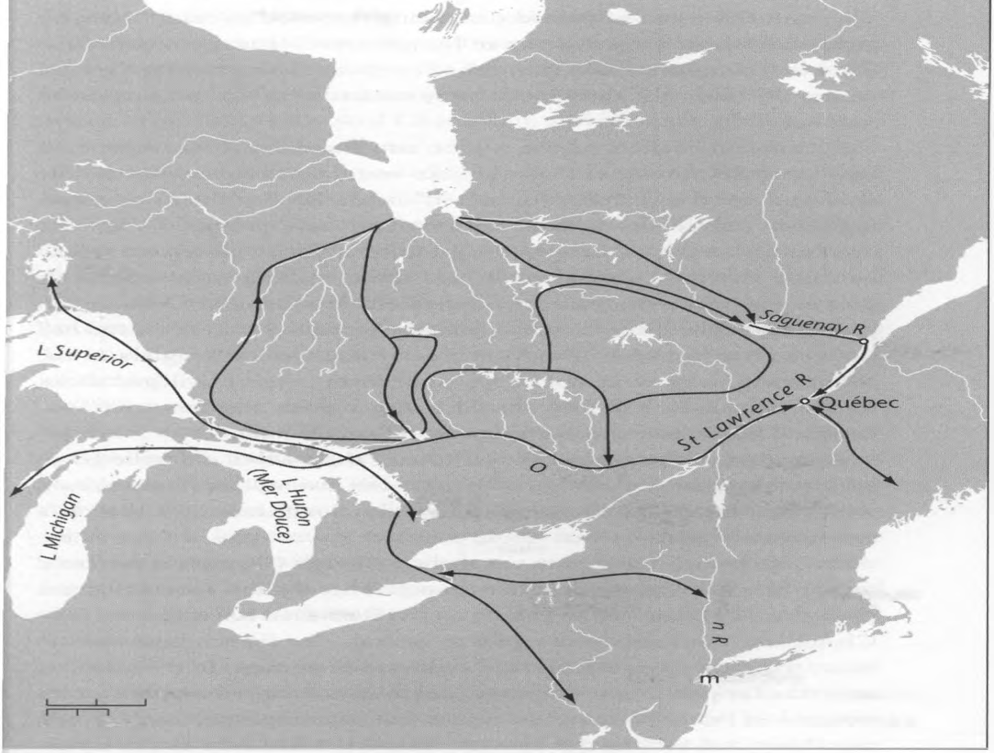
THE ROUTES OF GETTING TO CHINA

Slide 6
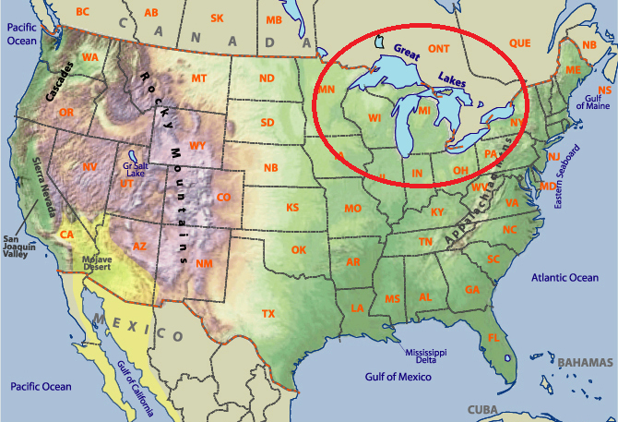
THE ROUTES OF GETTING TO CHINA

Slide 7
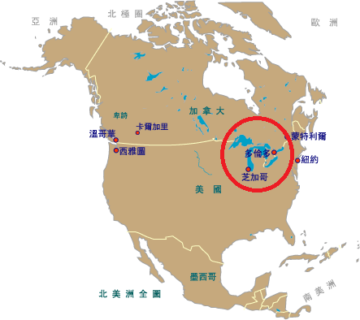
THE ROUTES OF GETTING TO CHINA

Slide 8
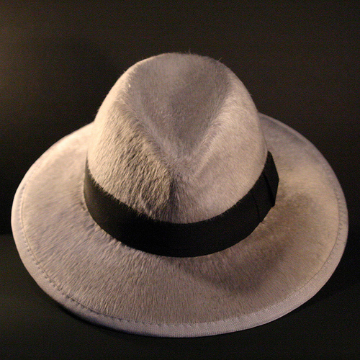
Vermeer’s hat
Hat is a symbol of social status, like nowadays Ipod, Iphone or Nike.
Men remove their hats while entering a building or greeting a woman. (How tiresome for the busy hand!)
Dutchmen are proud for they don’t have to take their hat down while meeting the monarch since they have none.

Slide 9
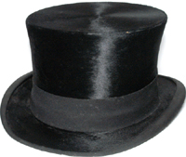
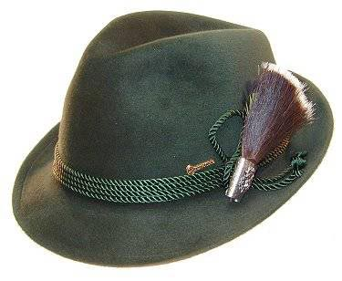
The beaver in the hat
Due to the fact that Europe’s beaver had walked unto history, Champlain asked Indians to provide beaver pelt constantly.
Beaver pelt can be made into excellent felt hat after chemical reproduction. It is too expensive for the poor to own a beaver hat, so they choose wool hat (Klapmuts) instead.
Klapmuts will loose shape whenever it get wet. In addition, it isn’t colorful.

Slide 10
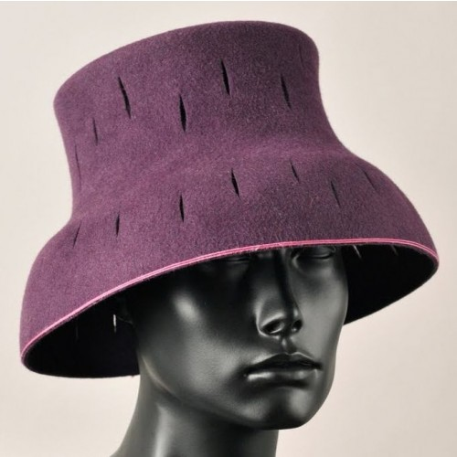
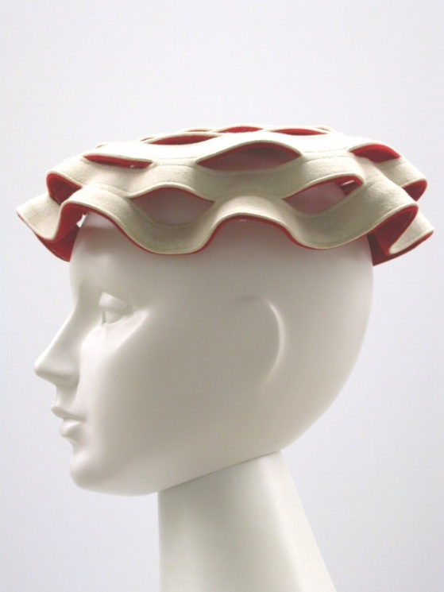
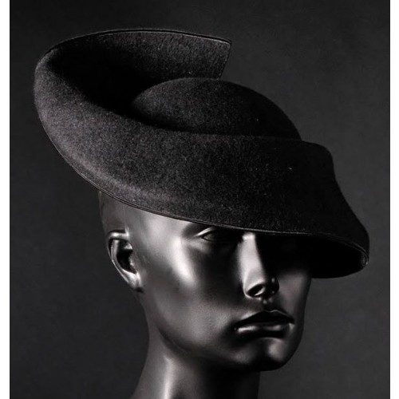
The crazy hat
Champlain monopolized the beaver hat market for ten years. Till 1609, he was forced to open his tight grasp. (The price went down for 60 percent)
In order to keep his advantages, he moved farther upriver. He also changed a son with the local tribe as a pledge of mutual support.
Meanwhile, the trend of hat became ridiculous and exaggerating because every consumer wanted to be the unique one.

Slide 11
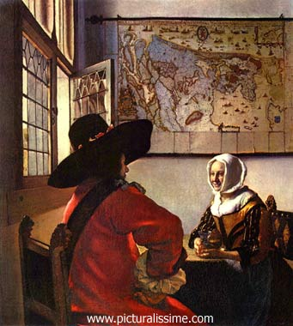
Art followed life
This is a courting scene. Rather than brothels, Vermeer chose interiors to show the change of custom. Unlike being as the spoil of war beforehand, women have to be pleased in 17th century. Men are no longer heroes of the independent war; they have to use romance to capture the opposite sex.
The exchange of color between land and sea in the Holland map hung in the back.

Slide 12
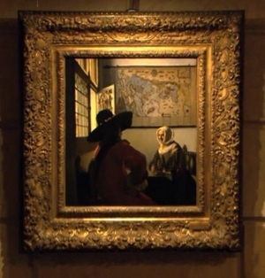
The transition
These reversals were part of the larger transition that Dutch society was undergoing in Vermeer’s time: from military to civil society, from monarchy to republicanism, from Catholicism to Calvinism, merchant house to corporation, empire to nation, war to trade.
Brook ( p. 28- p. 29)

Slide 13
Crown Point on Lake Champlain
On the morning of 30 July 1609

Slide 14
How did all this come about???
The European- Native relationship：the beginning of the long, slow destruction of a culture and a way of life from which neither side has yet recovered.

Slide 15
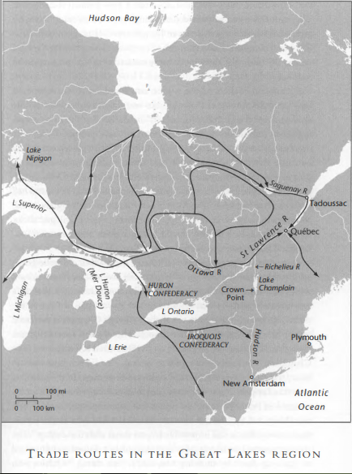
The All Beginning!
Montagnais

Slide 16
Huron Confederacy VS. Iroquois Confederacy
結盟(成員)
地理位置
M.
H.
A.
M.

Slide 17
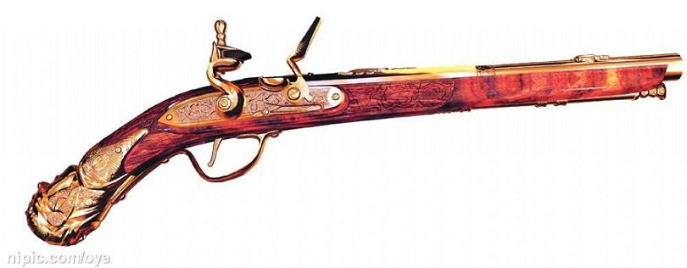
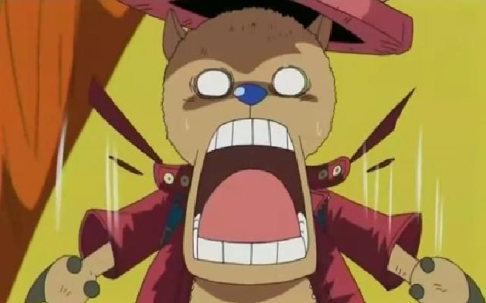
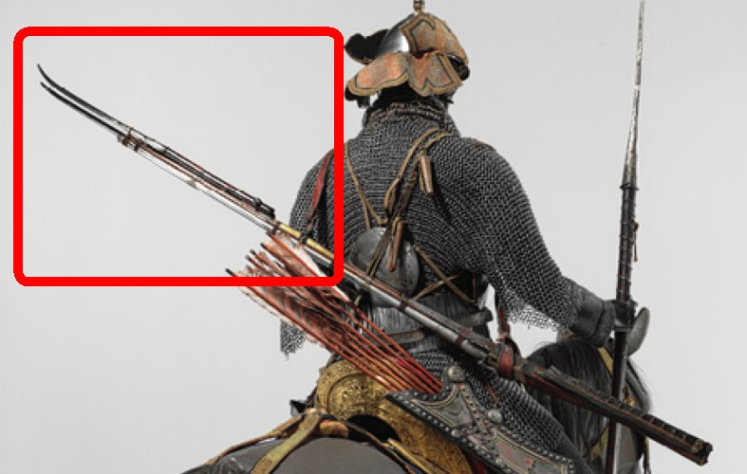
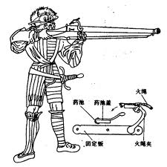
They froze in shock…
ARQUEBUS(火繩槍)

Slide 18
After the war…
They wanted to negotiate an enlargement of direct trading.
Wampum── a symbolize of currency and contract. → committed themselves to an alliance with French.
Fifty beaver pelt── founded good relationship between both sides.

Slide 19
Why the trade was such a success?
Before the 15 thc.→ indigenous→ overtrapping.
In the 16 thc. → sheep’s wool and rabbit hair → not ideal.
The end of 16 thc.→ Siberia→unreliable
→ Canada
The value between Native and European was different.

Slide 20
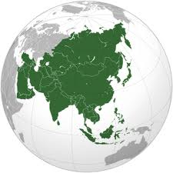
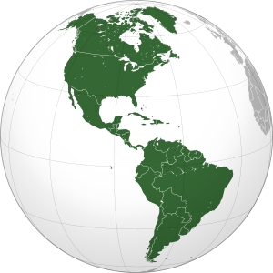
What he wanted…
Find out the path to China.
But it was totally wrong！！！

Slide 21
Cultural differences
Tactics in a war (p 35)
Divination & Dream (p 35-37)
Purpose and Goal (p 37)
Sacrifice (p 41)

Slide 22
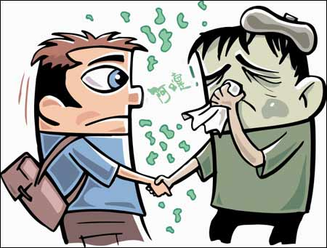
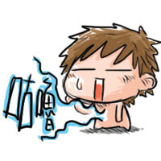
The destruction
Epidemic → slashed the population to a third of its original number of 25000.
They cannot defeat their enemy.
They lost their homeland. → Hunger

